Slide 1
Coevolution
c.f.Alex Kraaijeveld

Slide 2
Aims
Introduce concept of coevolution
Show how it is different from ‘normal’ evolution
Explain the difference between pairwise and diffuse
coevolution
Make clear why proving coevolution is not always
straightforward
Give a taste of the importance of models

Slide 3
Charles Darwin (1859) – The Origin of Species
It is interesting to contemplate an entangled bank, clothed with many plants of many kinds ..... with various insects flitting about ..... and to reflect that these elaborately constructed forms, so different from each other, and dependent on each other in so complex a manner, have all been produced by laws acting around us
Thus I can understand how a flower and a bee
might slowly become ..... modified and adapted in the most perfect manner to each other

Slide 4
Charles Darwin (1859) – The Origin of Species
It is interesting to contemplate an entangled bank, clothed with many plants of many kinds ..... with various insects flitting about ..... and to reflect that these elaborately constructed forms, so different from each other, and dependent on each other in so complex a manner, have all been produced by laws acting around us
Thus I can understand how a flower and a bee
might slowly become ..... modified and adapted in the most perfect manner to each other

Slide 5
Charles Darwin (1859) – The Origin of Species
It is interesting to contemplate an entangled bank, clothed with many plants of many kinds ..... with various insects flitting about ..... and to reflect that these elaborately constructed forms, so different from each other, and dependent on each other in so complex a manner, have all been produced by laws acting around us
Thus I can understand how a flower and a bee
might slowly become ..... modified and adapted in the most perfect manner to each other

Slide 6
Ehrlich & Raven (1964)
In-depth study of butterflies and their food plants
Presence of secondary plant compounds closely
connected to patterns of utilization
Plants evolve compounds to escape attack from
caterpillars (move into enemy-free space)
Caterpillars evolve resistance to compounds (move into
competitor-free space)
Coined term ‘coevolution’
Ehrlich & Raven (1964). Evolution 18: 586-608

Slide 7
Definitions of coevolution
sensu lato (broad):
“Evolution as a result of biological interactions”
sensu stricto (narrow) (Dan Janzen):
“An evolutionary change in a trait of the individuals in
one population in response to a trait of the individuals
in a second population, followed by an evolutionary
response by the second population to the change in the
first”
Essential element: reciprocity
Janzen (1980). Evolution 34: 611-612

Slide 8
Normal vs reciprocal evolution
Crucial difference between ‘normal’ evolution and
coevolution
In ‘normal’ evolution, the agent of selection does not
change as a result of the evolutionary response it
causes
environment
species 1

Slide 9
Normal vs reciprocal evolution
In coevolution, the agent of selection does change as
a result of the evolutionary response it causes
Positive feedback
mechanism
Arms race!
species 2
species 1

Slide 10
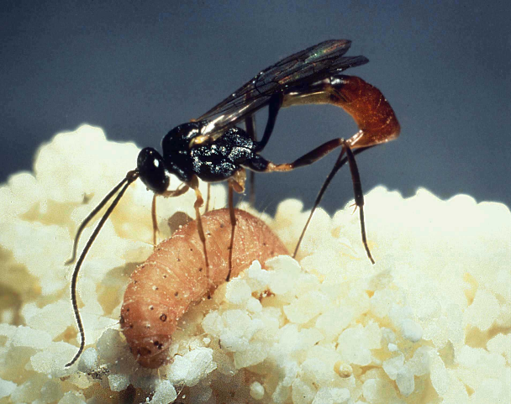
Pairwise and diffuse coevolution
resistance
parasitoid
A
B
host
counter-resistance

Slide 11
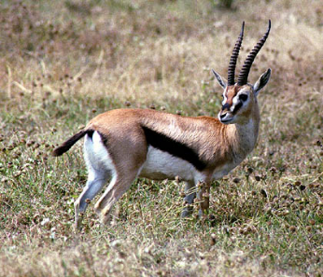
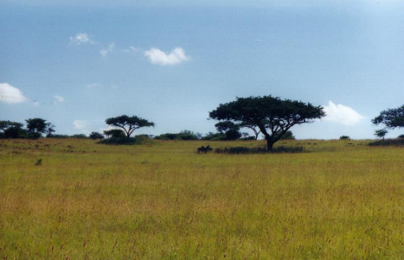
Pairwise and diffuse coevolution
tougher leaves
A
B
B
harder teeth

Slide 12
Pairwise and diffuse coevolution
A1
B1
A2
B2
A3
B3
A4
B4
A5
B5
Ax
By

Slide 13
Pairwise and diffuse coevolution
A1
B1
A2
B2
A3
B3
A4
B4
harder teeth
tougher leaves
A5
B5
Ax
By

Slide 14
Sasaki & Godfray model
Host is genetically variable for resistance
Negative correlation between resistance and fitness
Parasitoid is genetically variable for virulence
Negative correlation between virulence and fitness
Coupled population and evolutionary dynamics
Sasaki & Godfray (1999). Proc. Roy. Soc. B 266: 455-463

Slide 15
Sasaki & Godfray model
high cost of resistance - low cost of counter-resistance
Stable population dynamics
Stable genetic dynamics
Majority of hosts do not invest in resistance: trade-off
cost of resistance against risk of attack
Parasitoids have mostly fixed level of counter-
resistance

Slide 16
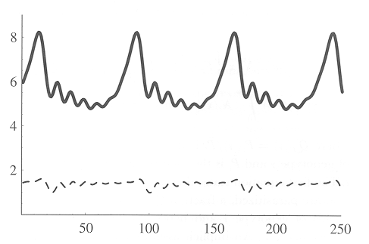
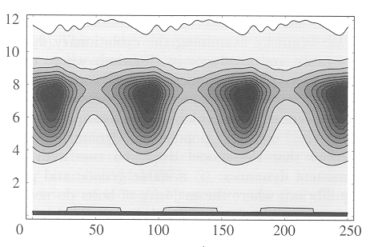
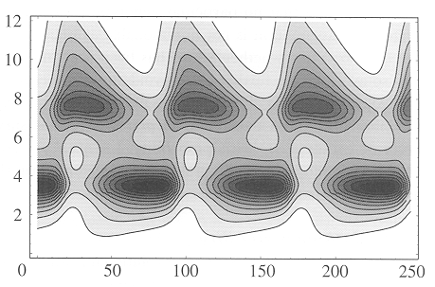
Sasaki & Godfray model
low costs of resistance and counter-resistance
Population size
Counter-
resistance
Resistance
Generations

Slide 17
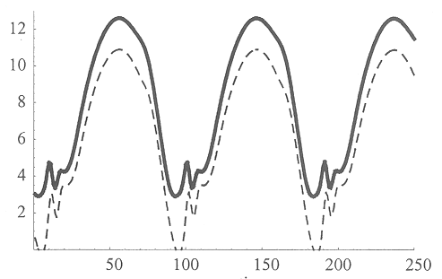
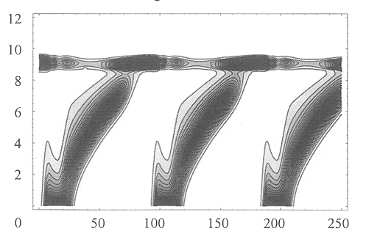
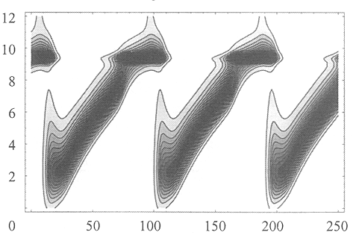
Sasaki & Godfray model
high costs of resistance and counter-resistance
Population size
Counter-
resistance
Resistance
Generations

Slide 18
end

Slide 19
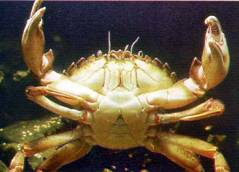
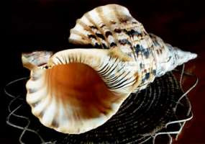
A coevolutionary story .....
strong pincers
thick shells

Slide 20
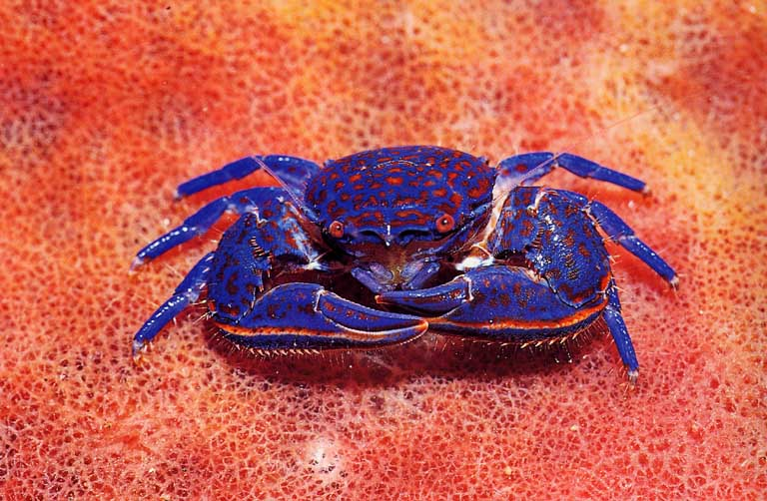
What really happened – phase 1
EXTINCT

Slide 21
What really happened – phase 2
✗

Slide 22
How to study coevolution?
Identify selection pressures * reciprocal?
* other species?
* abiotic factors?

Slide 23
How to study coevolution?
Identify selection pressures
Variation * across the range of the species under study
* in time

Slide 24
How to study coevolution?
Identify selection pressures
Variation
Trade-offs * are there costs of ‘being better’?

Slide 25
How to study coevolution?
Identify selection pressures
Variation
Trade-offs
Genetical background * of traits
* of variation in traits

Slide 26
How to study coevolution?
Identify selection pressures
Variation
Trade-offs
Genetical background
Dynamic aspects * population dynamics
* population genetics, changes in
gene frequencies

Slide 27
How to study coevolution?
Identify selection pressures
Variation
Trade-offs
Genetical background
Dynamic aspects
Modelling * gain insight into essential aspects

Slide 28

How to study coevolution?
Identify selection pressures
Variation
Trade-offs
Genetical background
Dynamic aspects
Modelling
Model of host-parasitoid interaction

Slide 29
To sum up .....
Explained how coevolution is different from
‘normal’ evolution
Talked about the difference between pairwise
and diffuse coevolution
Made clear why proving coevolution is not
always the easiest thing .....
Touched upon the value of models for gaining
insight into crucial aspects

